Slide 1
Heroica (story beats/highlights)
A superhero themed land
Created & written by Andrew J. Friedenthal

Slide 2
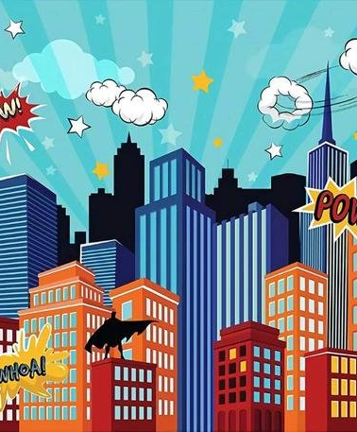
Overarching Story/Theme
You are invited to Heroica, the City of Superheroes, for the first-ever Origins Day! To keep pace with the many growing threats to the safety of the world, the city’s defenders have joined forces to create a new generation of superheroes . . . one of whom just might be you! And always remember our city slogan, “Everyone can be a superhero!”

Slide 3
Characters - Heroes
Professor Praetorian - Heroica’s favorite son and its “Prime Paragon of Propriety.”
KnightGuard – Heroica’s dark avenger of the night.
LazerBlast – Working mom and district attorney by day, superhero by night.
The Darklore Family - A family of wizards, warlocks, witches, and sorcerers whose lineage goes back to the founding of the city.
DragonGirl & Sparklebreath – An 11-year-old girl with a pet dragon.

Slide 4
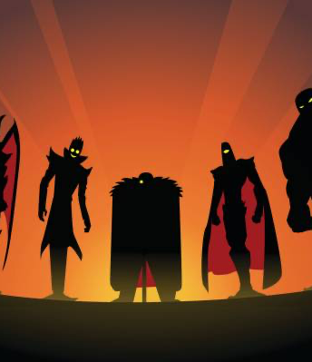
Characters - Villains
David Samson – A millionaire, genius business magnate who secretly controls the city’s villains.
The Brute - Eight feet, four hundred pounds of pure, mysterious purple muscle and rage.
Erika Darklore - The black sheep of the Darklore Family, and its one current practitioner of black magic.
The Association of Clean Living – A death cult masquerading as a gym/fitness club franchise.

Slide 5
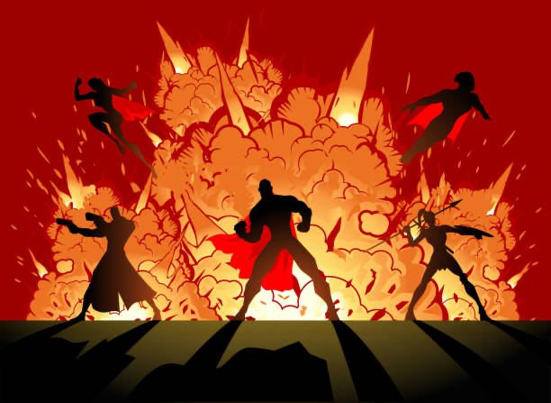
E-Ticket Dark Ride – The Hero’s Journey
Logline: Live the life of a superhero in this special invited tour of Heroica! When an emergency arises, visitors will have to take a more active role in helping Heroica’s dark urban avenger, KnightGuard, save the city from an organized attack by its greatest villains!

Slide 6
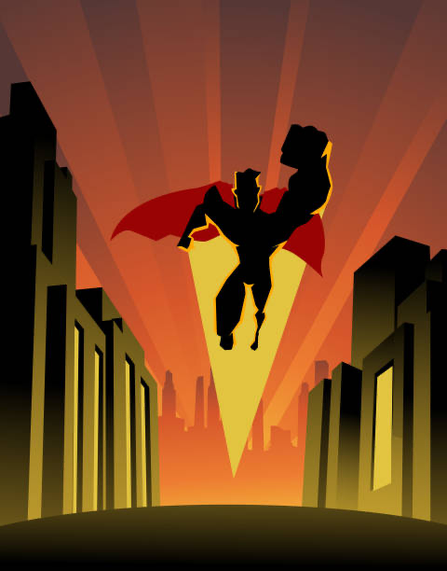
E-Ticket Dark Ride – The Hero’s Journey
Entrance/Queue Scenes
Entrance: The Consulate Exterior – headquarters of Heroica’s greatest superteam
Queue Room 1: Consulate Lobby
Queue Room 2: Consulate Trophy Room
Queue Room 3: Consulate Meeting Room
Queue Room 4: Consulate Private Quarters

Slide 7
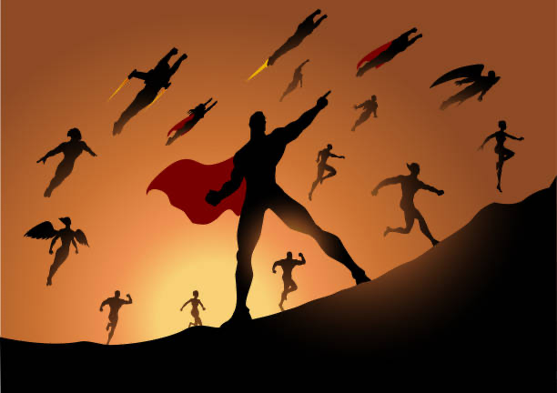
E-Ticket Dark Ride – The Hero’s Journey
Ride Scenes
Prologue: Loading Area (Consulate Vehicle Bay)
Beat 1: Exterior Tour - The vehicle exits to the exterior of the attraction, where it winds through the streets of Heroica on a raised platform.
Beat 2: KnightGuard Headquarters – Heroica’s dark avenger KnightGuard takes control of the vehicle and brings it to his headquarters.
Beat 3: Supervillain Takeover - Riders learn that the city is under attack from villains led by the evil David Samson, who takes over the vehicle.
Beat 4: Race Through The City Streets - Dozens of superheroes and villains battle on the streets and in the sky, the tour vehicle just barely avoiding several encounters as riders feel the heat of explosions and fiery blasts.
Beat 5: David Samson Secret Lair– David Samson attempts to mind control riders but KnightGuard arrives to save them just in time.
Beat 6: Exterior Chase – Under Samson’s control, the vehicle exits to the exterior of the attraction and speeds up intensely, banking and turning in the “thrill ride” portion of the attraction. They are saved just in time by KnightGuard regaining control of the vehicle.
Unloading: Consulate Vehicle Bay/Gift Shop Entrance

Slide 8
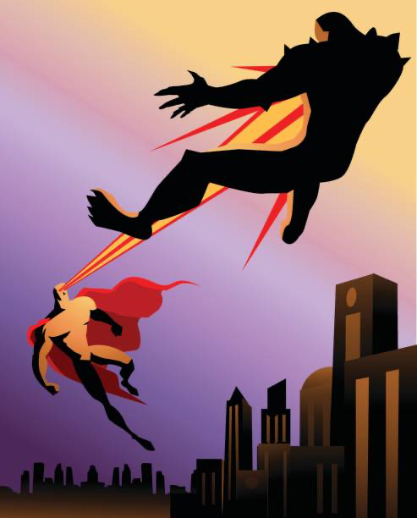
Roller Coaster – Attack of the Brute
Logline: Survive an attack from Heroica’s most destructive monster – The Brute – in a twisting, turning, upside-downing roller coaster of a ride!
Synopsis: Visitors to Heroica will experience first-hand what it’s like when the mindless monster known only as the Brute attacks the city! In an attempt to evacuate the beast’s downtown rampage, guests will board an air-tram to bring them to safety in another part of the city. However, just as the tram is about to depart, the Brute strikes, grabbing the vehicle and tossing it high in the air. A last-minute rescue from LazerBlast leads to a high-flying battle between the two titans, with the tram caught in the middle as it swoops, swerves, and dives to avoid becoming collateral damage!

Slide 9
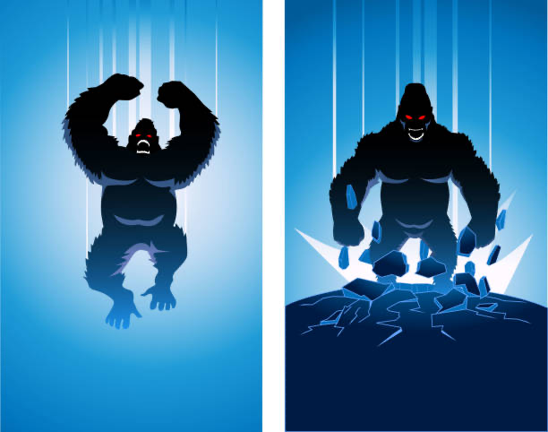
Roller Coaster – Attack of the Brute
Ride Script
The air-tram pulls out of the loading dock and proceeds slowly up the first incline as on-ride audio plays over dramatic music:
Announcer: Thank you for riding Heroica Air-Tram. Our next stop will be— [Static interrupts the announcement as LazerBlast breaks in.]
LazerBlast: Your next stop will be anywhere but here, as fast as you can get there! The Brute’s turned his attention to this station, and now he’s— [The air-tram slowly rolls backwards now, as if being pulled.] Oh no. Everyone, please remain calm. The Brute has . . . well, he’s caught onto your air-tram and it looks like he’s . . . [The car stops and the music cuts out.] Yeah, he’s gonna throw you.
The air-tram launches into the first hill as music and LazerBlast’s dialogue play from onboard audio.
LazerBlast: I’m going to create some heated updrafts to soften your fall, but hang tight, this’ll be bumpy ride!
The air-tram maneuvers through the first series of loops/drops. The on-ride audio features dramatic music as the sounds of a battle between Brute and LazerBlast (energy blasts, explosions, snarling, etc.) play out, ending with LazerBlast shouting:
LazerBlast: Wait, I’ve been trying to blast this guy with energy, but maybe I should try to absorb it from him!
The battle sounds continue, ending with a shout of triumph from LazerBlast as the air-tram rounds the final corner on its return to the unloading area.
Just before the unloading area is an animatronic or projection of LazerBlast standing over an unconscious Brute.
LazerBlast: Well, folks, we didn’t get you evacuated . . . but it looks like that air-tram really can survive everything they say it does. Now let me get this guy secured before he somehow slips away. Again.
The air-tram pulls into the unloading area and guests exit.

Slide 10
Flat Ride – Sparklebreath Spinners
Logline: Take a gentle ride on Heroica’s favorite fire-breather, Sparklebreath the dragon, as a special treat for Origin Day!
Synopsis: In this family-friendly spinner flat ride, guests get to climb onto Sparklebreath the dragon and experience what it’s like to soar through the skies of Heroica!

Slide 11
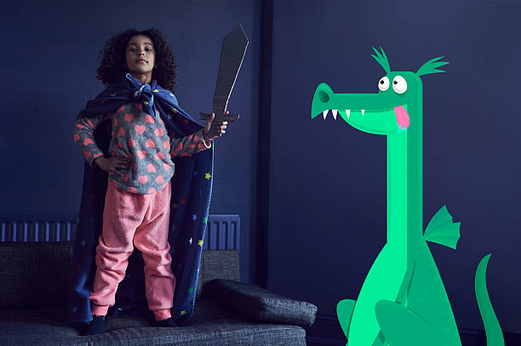
Flat Ride – Sparklebreath Spinners
Ride Script
Riders load onto the spinning dragons, and the opening announcement comes from Dragon Girl:
Dragon Girl: Hi everyone! Dragon Girl here, and me and Sparklebreath hope you enjoy this special treat! Normally he just lets me ride on him, but today he wants to take all of you for a flight. So, hang on tight and keep your arms and legs inside the dragon at all times, because away we go!
The spinners circle around, allowing riders to control the height of each “dragon.” As the ride is ready to slow, Dragon Girl makes another announcement:
Dragon Girl: OK, I think Sparklebreath is starting to get a little tired, so he’s gonna set down. But thanks for flying through Heroica with us! And watch out for that stinky dragon breath!
As ride cars settle to ground, each one exhales a plume of “dragon breath” smoke from the dragons’ nostrils.

Slide 12
Daytime Live Stage Show – Everyone Can Be A Superhero
Logline: Celebrate Origins Day with this stunning display of Professor Praetorian’s newest inventions, where you may just get the chance to gain your own superpowers!
Synopsis: The centerpiece of Origins Day, this stage show purports to be a demonstration at Professor Praetorian’s lab where he will give superpowers to any member of the audience who so desire, beginning with several volunteers selected before the show. However, when an evil cult attacks just as he is revealing the process, Heroica’s favorite son must get the assistance of these volunteers to save the day.

Slide 13
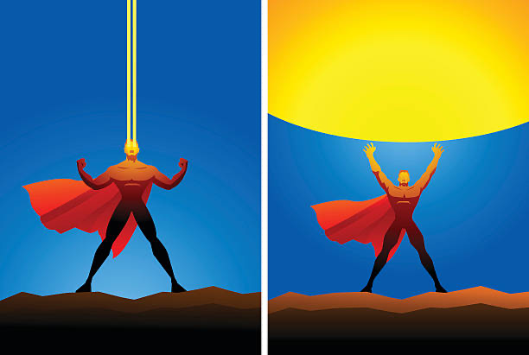
Nighttime Spectacular – Fire In The Sky
Logline: A display of nighttime magic and wonder from Augustine Darklore, Heroica’s most talented mage, reveals the wonders – and dangers! – of the City of Superheroes!
Synopsis: To close out Origins Day, Augustine Darklore – the city’s most powerful mage and the patriarch of the secretive Darklore family – presents a nighttime spectacular in the form of an “innocent and charming display magical delights.” However, the presentation gets a tad out of hand when his estranged daughter, Erika, takes control and summons forth some of the city’s most powerful villains. Can Heroica’s greatest heroes stop them in time to prevent an even greater catastrophe from occurring?
[Note: The script deliberately refrains from suggesting how particular effects should be realized and can be altered to fit the practicality of achieving them via projection, animatronics, water screens, stage illusions, etc.]

Slide 14
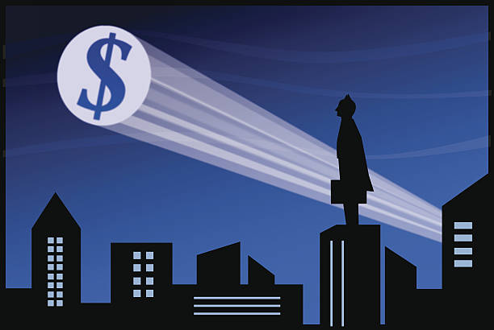
List of Heroica Stores
Store 1
Name: Haul of Heroes
Theme: Heroica’s #1 department store! (main Heroica giftshop)
Products: Clothing and memorabilia; non-diegetic souvenirs
Store 2
Name: Consulate Goods
Theme: The official giftshop of the Heroica Council! (“The Hero’s Journey” ride exits here)
Products: Clothing and memorabilia; Heroica Council/Consulate/“The Hero’s Journey” items
Store 3
Name: Super-Models
Theme: Selling superhero costumes and cosplay accoutrement, plus a salon where kids can pick out their own bespoke superhero makeup, costume, and powers!
Products: Costuming; children’s cosplay salon experience
Store 4
Name: SuperScience Sellers
Theme: A store dedicated to Professor Praetorian and the other science-based heroes of Heroica!
Products: Clothing and memorabilia; science kits; Professor Praetorian, KnightGuard, & LazerBlast souvenirs; “Everyone Can Be A Hero” souvenirs
Store 5
Name: Darklore Goods & Antiquities
Theme: A small store of esoterica run by the mysterious, magic-wielding Darklore family!. (part store, part walk-through attraction of various magical and eerie illusions)
Products: Clothing and memorabilia; Darklore family souvenirs; magic kits/items; “Fire In The Sky!” souvenirs

Slide 15
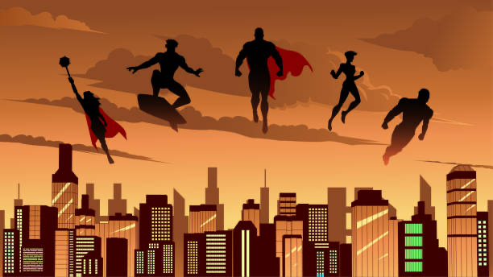
List of Heroica Restaurants
Restaurant 1
Name: The Hero’s Feast
Theme: Character dining where guests can meet and interact with the Heroica Council and other heroes of the city.
Menu: Buffet-style
Restaurant 2
Name: Consulate Cafeteria
Theme: The cafeteria for the Consulate, complete with photos, props, occasional superheroes coming through, etc. (attached to the exterior of “The Hero’s Journey” show building)
Menu: Basic cafeteria food (hamburgers, hot dogs, chicken, sandwiches/wraps, soup/salad)
Restaurant 3
Name: The Restaurant With No Name
Theme: A villain-themed sit-down restaurant, with rooms designed after different types of villainous lairs (mad scientist’s lab, abandoned warehouse, underground cavern, alien throne room, etc.); hosts/hostesses/servers are costumed as villains’ henchmen/henchwomen.
Menu: Steakhouse fare; alcoholic drinks (only place in Heroica to buy alcohol)
Restaurant 4
Name: Heroica Morsels
Theme: A coffee shop with framed/signed photos of the city’s heroes
Menu: Coffee: tea; baked goods; simple sandwiches and wraps
Restaurant 5
Name: Snack of the Brute!
Theme: A fast-service food counter themed to the Brute. (located near “Attack of the Brute!”)
Menu: Brutecorn (popcorn died purple in various flavors – “packed with monstrously explosive flavor!”); “Brute!” brand energy drinks & Slurpee’s; pizza
Restaurant 6
Name: Dragon Bites
Theme: Cafeteria-style restaurant billed as “Dragon Girl’s Favorite Restaurant!”, with “damage” from Sparklebreath throughout
Menu: Kid-friendly cuisine – hamburgers, hot dogs, peanut butter & jelly, mac & cheese, chicken strips, etc.

Slide 16
Flavor Text – Plaques Throughout Land
Plaque 1 – The Consulate
Plaque 2 – Heroica Air-Tram System
Plaque 3 – Professor Praetorian’s Laboratory and Headquarters
Plaque 4 – Kurtzburg Lagoon
Plaque 5 – Dragon’s Den neighborhood
Plaque 6 – Haul of Heroes department store
Plaque 7 – Darklore Manor
Plaque 8 – Brute Ground Zero
Plaque 9 – The Restaurant With No Name
Plaque 10 – Heroica City Hall
Plaque 11 – Lieberman Building (office building)
Plaque 12 – Intersection of Siegel Avenue and Schuster Street
Plaque 13 – Ross’ Gym
Plaque 14 – The Busiek (apartment building)
Plaque 15 – Redacted (government building, purpose unknown)

